Slide 1
DATA STRUCTURES Binary Search Trees
By
Dr. Shubhangi Sapkal

Slide 2
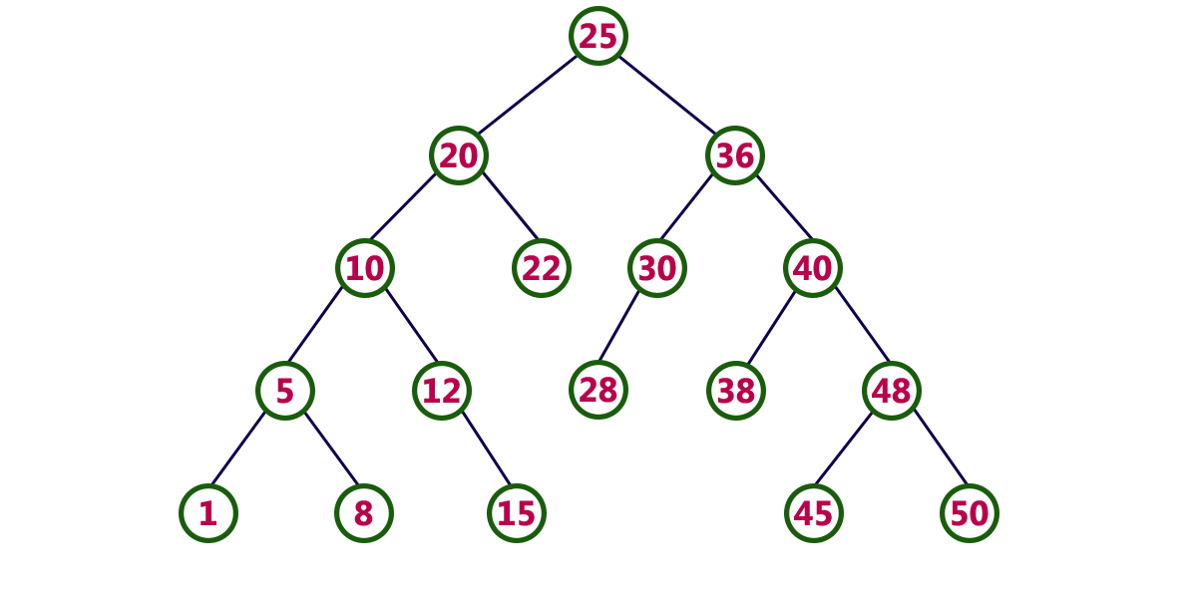
Binary Search tree
In a binary tree, every node can have a maximum of two children
Binary search tree is a binary tree in which every node contains only smaller values in its left subtree and only larger values in its right subtree

Slide 3
Operations on a Binary Search Tree
The following operations are performed on a binary search tree...
Search
Insertion
Deletion

Slide 4
Search Operation in BST
In a binary search tree, the search operation is performed with O(log n) time complexity. The search operation is performed as follows... Step 1 - Read the search element from the user.
Step 2 - Compare the search element with the value of root node in the tree.
Step 3 - If both are matched, then display "Given node is found!!!" and terminate the function
Step 4 - If both are not matched, then check whether search element is smaller or larger than that node value.
Step 5 - If search element is smaller, then continue the search process in left subtree.
Step 6- If search element is larger, then continue the search process in right subtree.
Step 7 - Repeat the same until we find the exact element or until the search element is compared with the leaf node
Step 8 - If we reach to the node having the value equal to the search value then display "Element is found" and terminate the function.
Step 9 - If we reach to the leaf node and if it is also not matched with the search element, then display "Element is not found" and terminate the function.

Slide 5
Insertion Operation in BST
In a binary search tree, the insertion operation is performed with O(log n) time complexity. In binary search tree, new node is always inserted as a leaf node. The insertion operation is performed as follows
Step 1 - Create a newNode with given value and set its left and right to NULL.
Step 2 - Check whether tree is Empty.
Step 3 - If the tree is Empty, then set root to newNode.
Step 4 - If the tree is Not Empty, then check whether the value of newNode is smaller or larger than the node (here it is root node).
Step5 – If new node is smaller than or equal to the node then move to its left child. If newNode is larher than the node then move to its right.
Step6 – Repeat the above steps till we reach to the leaf node.
Step7 - After reaching the leaf node, insert the new node as left child if it is smaller or equal to the leaf node or insert it as right node.

Slide 6
Deletion Operation in BST
In a binary search tree, the deletion operation is performed with O(log n) time complexity. Deleting a node from Binary search tree includes following three cases...
Case 1: Deleting a Leaf node (A node with no children)
Case 2: Deleting a node with one child
Case 3: Deleting a node with two children

Slide 7
Case 1: Deleting a leaf node
We use the following steps to delete a leaf node from BST
Step 1 - Find the node to be deleted using search operation
Step 2 - Delete the node using free function (If it is a leaf) and terminate the function.

Slide 8
Case 2: Deleting a node with one child
We use the following steps to delete a node with one child from BST...
Step 1 - Find the node to be deleted using search operation
Step 2 - If it has only one child then create a link between its parent node and child node.
Step 3 - Delete the node using free function and terminate the function.

Slide 9
Case 3: Deleting a node with two children
We use the following steps to delete a node with two children from BST...
Step 1 - Find the node to be deleted using search operation
Step 2 - If it has two children, then find the largest node in its left subtree (OR) the smallest node in its right subtree.
Step 3 - Swap both deleting node and node which is found in the above step.
Step 4 - Then check whether deleting node came to case 1 or case 2 or else goto step 2
Step 5 - If it comes to case 1, then delete using case 1 logic.
Step 6- If it comes to case 2, then delete using case 2 logic.
Step 7 - Repeat the same process until the node is deleted from the tree.

Slide 10
Example
Construct a Binary Search Tree by inserting the following sequence of numbers...
10,12,5,4,20,8,7,15 and 13

Slide 11
